Slide 1
VLMs for Autonomous Battle Damage Assessment (BDA)
End-Phase II
MAR 16, 2026

Slide 2
VLMs for Autonomous Battle Damage Assessment
Project Overview:
Background
Data Engineering
Modeling
Project Plan
Team Members:
William Benitez: Prompt Engineer
Carlos Gil: Software Developer
Nicholas Lind: Data Engineer
Benjamin Siegel: ML Engineer
Cory Wingate: Project Manager/DevOps
AI2C Scholar and Mentors:
Jesse Barkley: AI Scholar
Derrik Asher: Army Research Lab
Jason Pusey: Army Research Lab

Slide 3
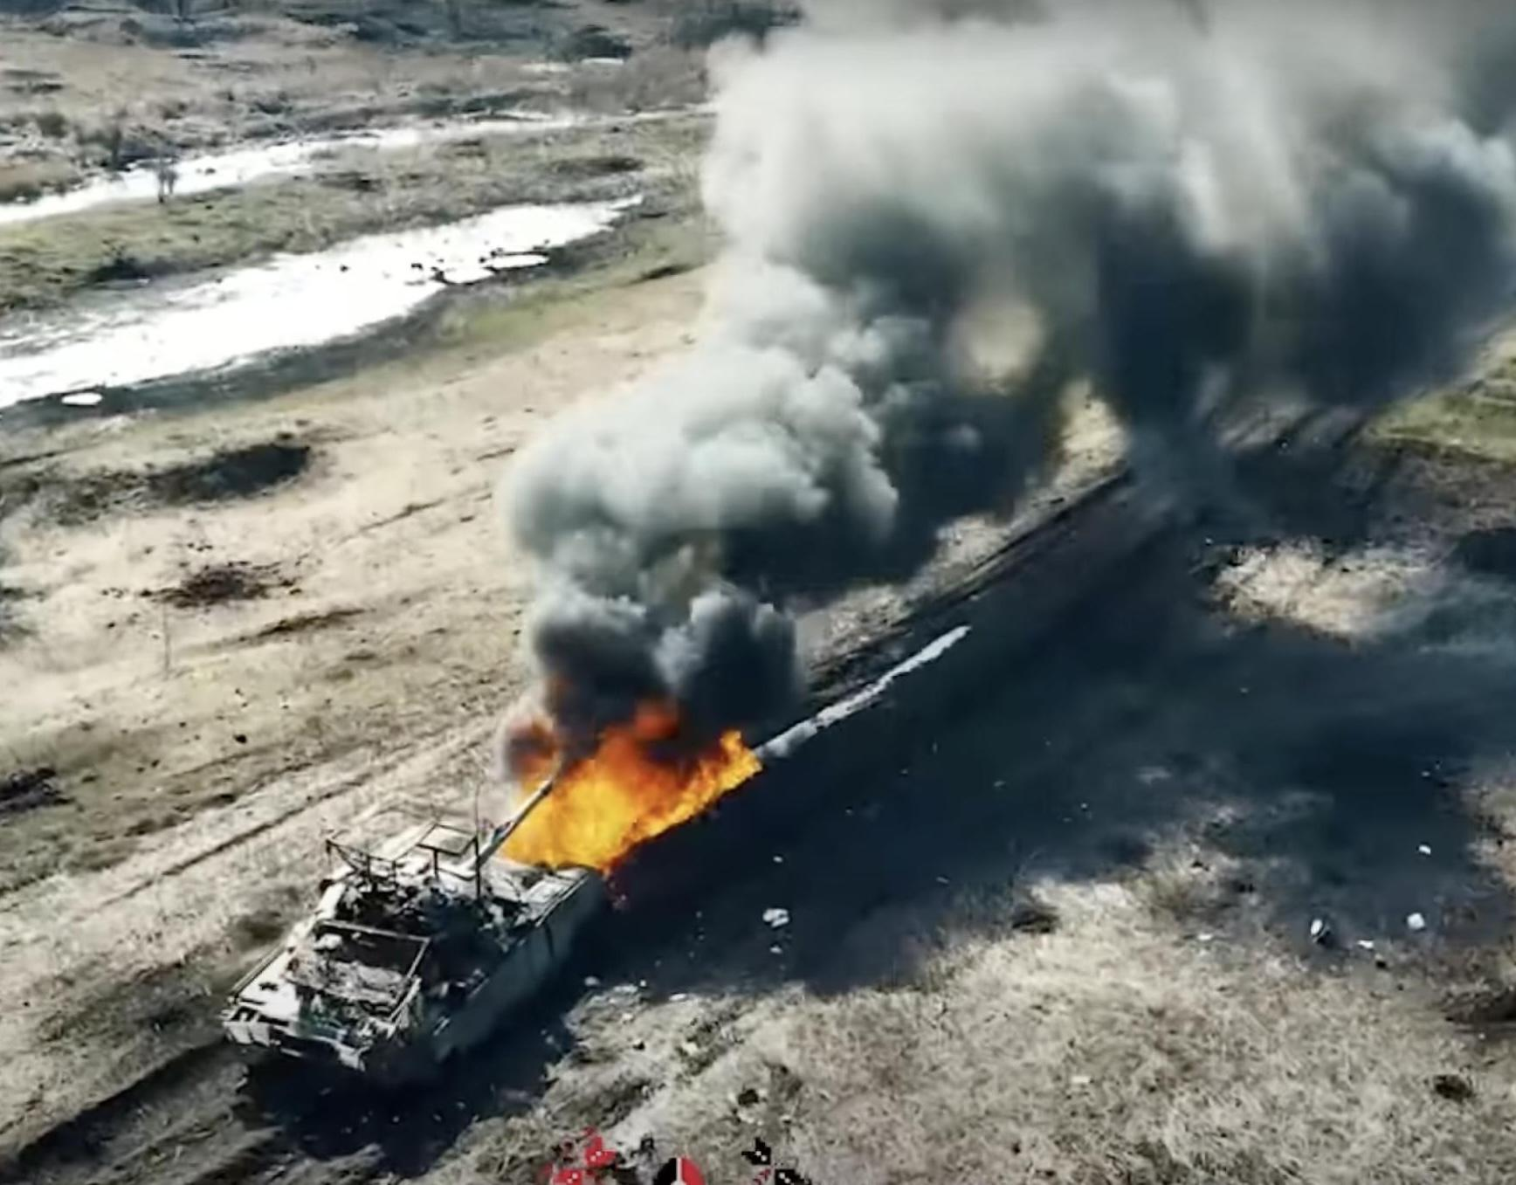
Background
A Battle Damage Assessment (BDA) “provides the timely and accurate estimate of damage resulting from the application of lethal and nonlethal military force.”
(Methodology for Combat Assessment - Joint Staff)
Notes:
Doctrine defines a BDA as the timely and accurate estimate of damage resulting from lethal and nonlethal military force. That estimate drives the commander’s reattack decision and shapes follow on targeting and maneuver. From a single snapshot, an analyst can capture obvious physical effects and produce initial BDA inputs. However, the current process still depends on trained analysts applying human judgment, which is manpower intensive, subjective, and does not scale in high tempo operations. The comprehensive nature of BDA makes it slow; large volumes of reporting can overwhelm analysts and delay decisions. Errors in the process can become dangerous when commanders demand high confidence and teams must push for additional collection in contested environments. Finally, BDA Outputs are also inconsistent and not standardized across analysts and organizations, leading to uneven quality, duplicate reporting, and friction during reconciliation.

Slide 4
Problem Set
Operational Problem
Requires Human Analyst
Inconsistent, Not Standardized
Slow
Current Methodologies
Dangerous
Experimental Tooling
Doctrinal Grounding
Model Evaluation
Resulting Gap
No standardized, portable, and validated pipeline for VLM‑generated BDAs
Notes:
Operational Problem
BDA requires rapid, accurate assessment
Relies heavily on human analysts
Process is slow, risky, and inconsistent
Key Problems
1. Doctrinal Alignment — Model outputs not aligned with BDA doctrine
2. Model Evaluation — No objective framework to measure model performance
3. Research‑Only Tooling — Experiments exist mainly in research notebooks, not deployable systems
Resulting Gap
No standardized, portable, and validated pipeline for VLM‑generated BDA

Slide 5
Proposed Solution
We are objectively evaluating VLM-generated BDAs using open-source data, as well as developing a portable environment to create VLM-generated BDAs on edge devices operating within research environments.
Notes:
To tackle these challenges, we are objectively scoring VLM generated BDAs to measure accuracy, doctrinal alignment, and failure modes as well as developing a portable, offline environment for edge devices in research settings with pinned dependencies and repeatable execution, so BDA outputs are reproducible, versioned, and traceable.

Slide 6
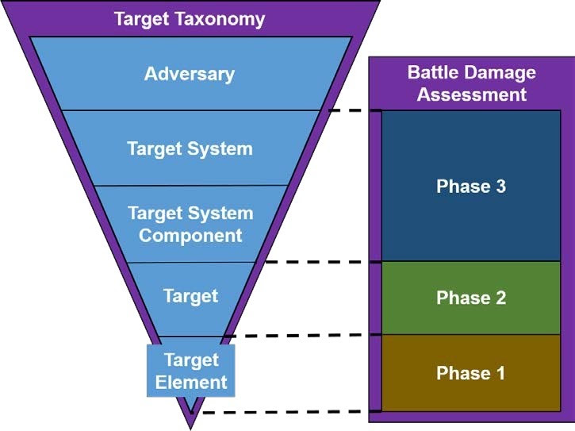
Data Requirements For BDA - Target Focused
Target Type
Damage Category
Confidence Level
“One vehicle is assessed as DESTROYED (CONFIRMED)”
Notes:
We are focusing the VLM on Phase 1 BDA, the initial, time sensitive physical damage assessment immediately after a strike. Phase 1 is where imagery is most useful because it captures observable effects like fire, smoke, wreckage, and structural collapse, and it is often based on single source reporting. We focus on the VLM reporting on the target element identifier, the Phase 1 physical damage category, and provide a confidence level tied to what is visible in the image according to doctrine.
The Target reported are objects identified in the scene of military importance, example: building, military vehicle, military equipment, bridge, road, etc
Phase 1 Physical Damage can range from:
NO DAMAGE - No apparent/observable damage.
LIGHT DAMAGE
MODERATE DAMAGE - All spans intact, but one or more spans damaged.
SEVERE DAMAGE
DESTROYED
Confidence is based on 3 levels
confirmed — clear, direct visual evidence (>= 95 percent confidence)
probable — visible but partially obscured or ambiguous (50 to 94 percent confidence)
possible — weak or limited visual indicators (<50 percent confidence

Slide 7
Data Requirements For BDA - Out Of Scope
Target System Impact
Recuperation Time
Re-Attack Rec.
Task Assessment
*Requires Mission Context (OPORD) and MOE
Scene Level
Functional Damage Level
*Requires All Source Intelligence Fusion
Notes:
Phase 2 and Phase 3 are where BDA stops being an image problem. Phase 2 estimates functional damage at the scene level and requires all source fusion over time. Phase 3 rolls that forward into target system impact, recuperation time, re attack recommendation, and task assessment tied to mission Measures of Effectiveness and OPORDs. A VLM is not viable for Phase 2–3 from imagery because functional effects are often non observable and the conclusions depend on fused intelligence and mission context. If forced, it will either stay generic or over infer and produce non defensible outputs.
Pass to Carlos

Slide 8







Input
- Model prompt
- Model parameters
bda-svc
- Military Doctrine
- Object types
- Damage
Exception Handling if image is not a supported file format
Notes:
Our system automates Phase 1 of the BDA process and includes limited Phase 2 functionality when the image supports it. This slide shows that transformation: raw image in, structured JSON assessment out, with categories, labels, and confidence scores

Slide 9
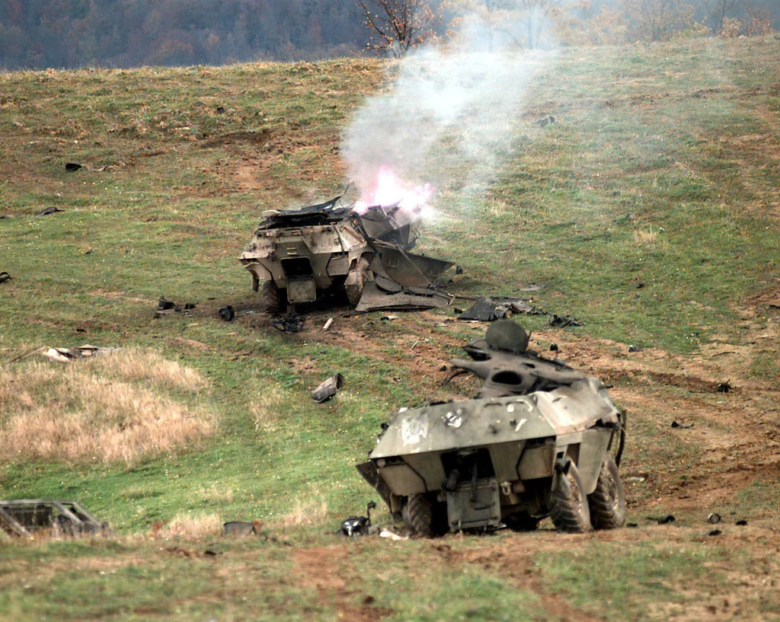
Output
{
" metadata ": {
" image_id "
“ image_filename ”
" date_created "
" location : {
“crs”
“coordinates”
},
" report_type "
" analyst "
},
" physical_damage " : {
" target_1 " : {
" bounding_box " : {
" xmin ": 314, " ymin ": 256, " xmax ": 555, " ymax ": 433
},
" target_type "
" damage_category "
" confidence_level "
" brief_supporting_logic "
},
" target_2 " : {
. . .
}
}
}
: “ 6608e9e-1f12-409d-8234-0b74a09b844f ”,
: “ field_multi_mil_042.jpg ",
: “ 2026-02-19T20:31:25Z ”,
: “ MGRS ”,
: “ 17T NE 8961 7759 ”,
: “ PDA ”,
: “ bda-svc ”
: " military_equipment ",
: " DESTROYED ",
: " PROBABLE ",
: " Damaged hull, smoke … "
target_1
target_2
Notes:
Our system automates Phase 1 of the BDA process. This slide shows that transformation: raw image in, structured JSON assessment out, with categories, labels, and confidence scores

Slide 10



Software Deliverable
Robotic Platform
Executable
Validate
Preprocess
Output
Store
Self-contained software and model
Read input folder
Write output folder
Prompt input
BDA Analysis
JSON Output
Docker Runtime
NVIDIA Jetson

Slide 11
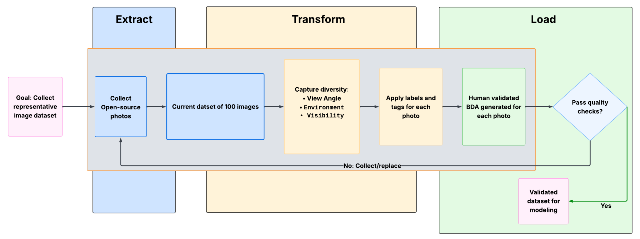
Data
Notes:
We’ve collected 100 open‑source images that cover a wide range of real conflict environments. This gives us a strong starting point for testing and improving our workflow before we scale up. We focused on capturing variety so the dataset reflects the unpredictable nature of real scenes. Each image is given a label (01 - 100) and is sorted in a spreadsheet by major category, and minor if it applies. The data is then input into RoboFlow to manually annotate labels and bounding boxes. Finally, a human report is created with a damage level being output at the end for each target in the image. That means the dataset isn’t just collected — it’s checked, graded, and ready to use. If an image doesn’t meet our standards, we replace it to keep the dataset clean and reliable. We’re starting with 100 images, but our goal is to grow to 200 and eventually toward around 500. Overall, this pipeline shows we’re building a repeatable process, not just gathering pictures.

Slide 12
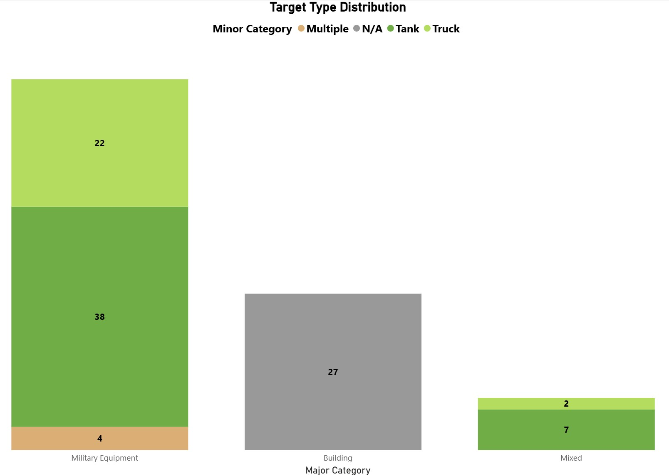
Data Composition (Major Categories)
Notes:
Currently our dataset is weighted towards military equipment. Across all categories, scenes can contain either a single object or multiple objects.
The Left bar is only military equipment with only trucks (22 %), only tanks (38%), and both trucks and tanks (4 %). 64%
The middle bar is just images of buildings (27 %)
The right bar is an image that has to have a building in it and also include either a tank (7 %)or a truck (2%) 9%

Slide 13
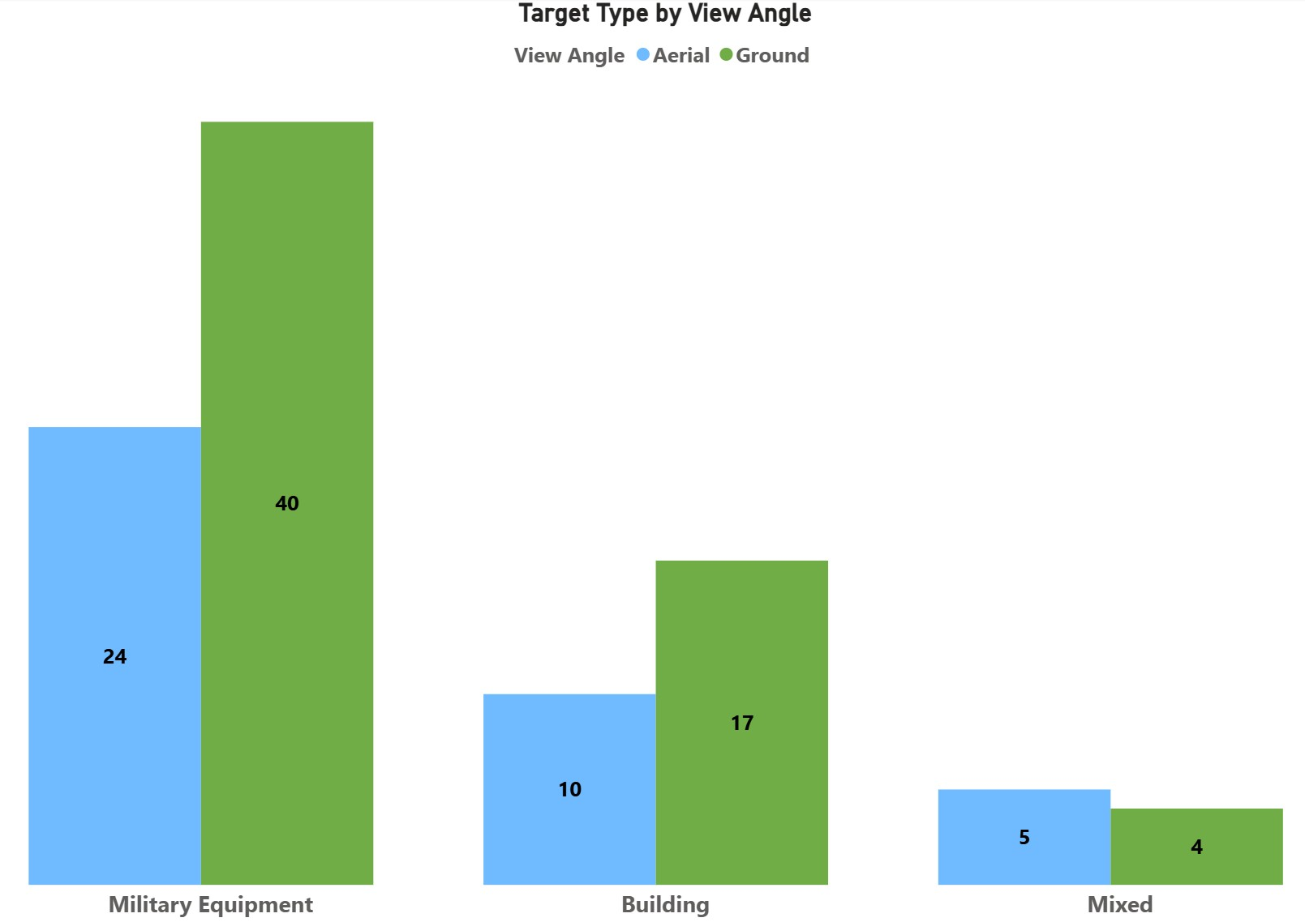
Data Composition (Look Angle)
Notes:
Right now in our dataset of 100 images 61 are ground based photos. The set is skewed more towards ground level imagery as an end goal of ours is to deploy on a ground based robotics platform. Blue bars represent aerial photos, and green represent ground level.
Hand over to Iggy to talk about the modeling

Slide 14
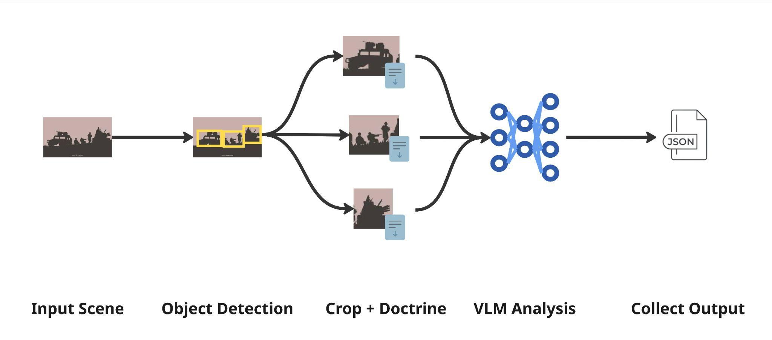
Modeling
Notes:
We take a post-strike image as input. The first stage uses an object detection model to localize potential targets of interest, such as buildings or military equipment.
For each detection, the system creates a buffered crop around the object while still retaining the full scene context.
These crops are then passed to a vision-language model along with doctrinal guidance for that target type. The VLM evaluates the visual evidence and determines the level of damage, confidence level, and supporting reasoning.
Finally, the outputs for all detected targets are consolidated into a structured JSON report describing what was assessed, where it was located, and the assessed damage category.
The key idea is separating localization from reasoning so we can independently improve detection and damage assessment models.

Slide 15
Evaluation
Match Targets
Compare prediction vs. reference targets
Match targets using IoU overlap
Structured Attribute Score
Target category
Damage level
Confidence level
Logic Quality Score
LLM as a judge
Score logic on 0-2 scale
Scene Score
Aggregate / Normalize target scores
Penalize FP / FN
Notes:
A major goal of this project is objective evaluation – how do we know how well the model performs?
First predicted targets are matched to reference targets based on target category and bounding box overlap
Next, we score the structured attributes of each matched target – the target type, damage level, and confidence (taking into account that some categories are ordinal i.e. “destroyed” is more similar to “severely damaged” than “no damage”)
We then evaluate the logical quality of each assessment using a language model judge, which scores whether the explanation aligns with the evidence in the reference label.
Finally, all target scores are aggregated to produce a scene-level score, normalized by the number of reference targets and applying penalties for any false positives or false negatives (targets the model hallucinated or did not match)
This evaluation pipeline combines detection accuracy, attribute correctness, and logical quality all into a single scene-level metric.
This allows us to compare different models and configurations objectively.

Slide 16
Plan
Milestone 1 08FEB26
Milestone 2 15MAR26
Milestone 3 12APR26
Milestone 4 05MAY26
Milestone 5 11MAY26
Requirements, Design, Planning
Dataset Labeling, Model Design
Pipeline Validations, Containerization
Model Evaluation, Robotic Testing
Project Presentation
- Problem Statement
- Requirements
- Design Plan
- Phase 1 Documents
- Dataset Identification
- Data Labeling
- Pipeline/Model Dev
- Phase 2 Documents
- Prompt Finalization
- Pipeline Validation
- Container Dev
- Phase 3 Documents
- Evaluation Execution
- Results Analysis
- Robotic Deployment
- Phase 4 Documents
- Final Presentation
- Artifact Submissions

Slide 17
Questions?

Slide 18
Hidden Slides

Slide 19
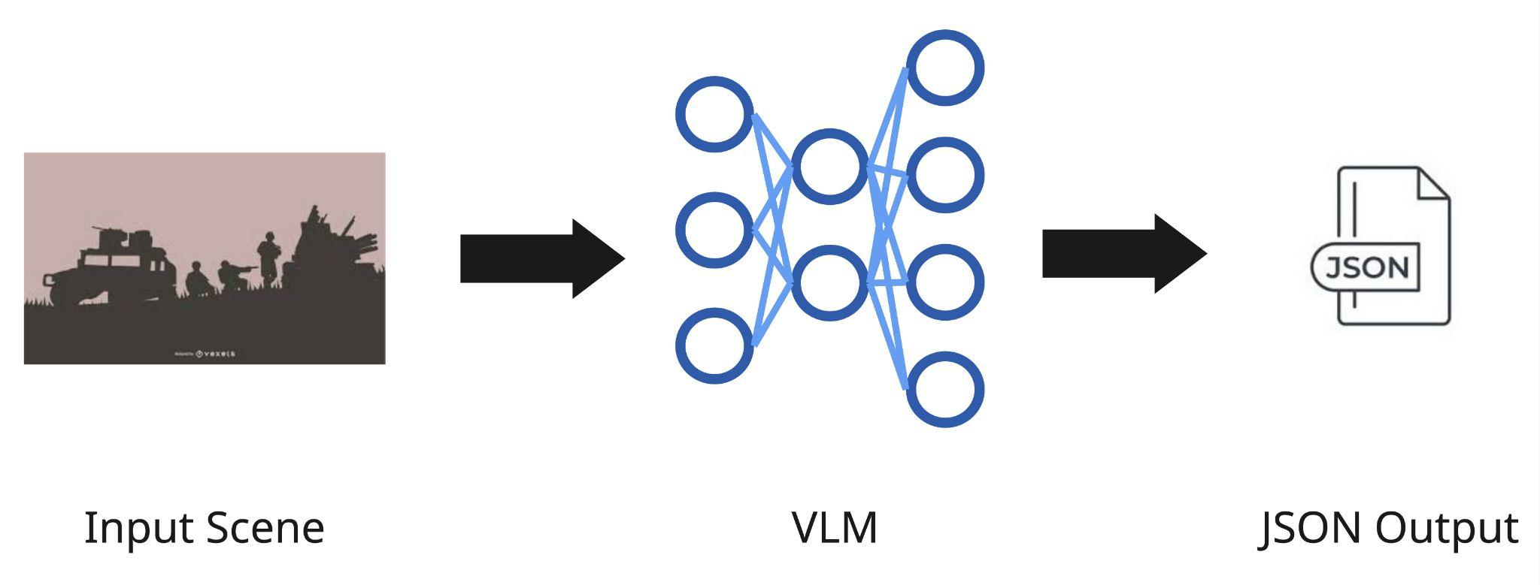
Background - Current Methodology
PROBLEMS
1 | Vague doctrinal adherence
2 | Lack of objective evaluation
3 | Software in early development
Notes:
The current method by ARL takes a single image, feeds it to a VLM, and outputs a JSON report.
Challenges that have been previously faced by the ARL team: If the prompt and schema are not aligned to doctrinal definitions, phases, and confidence rules, the output can drift from while still seeming authoritative. Understanding the Model quality and evaluation is critical because you must measure accuracy and calibrate confidence on the mission dataset, or mistakes and hallucinations will scale fast. Jupyter notebooks add delivery challenges through weak repeatability, making outputs harder to reproduce, audit, and version.

Slide 20
Data Requirements For BDA
Recuperation Time
Re-Attack Rec.
Task Assessment
Requires Mission Context (OPORD)
Notes:
Phase 3 is the target system assessment. It consolidates Phase 1 and Phase 2 reporting over time and estimates system level impact on a deliberate battle rhythm. This is where recuperation time, reattack recommendation, and task assessment require mission context tied to measures of effectiveness and planning products like the OPORD. A VLM is not viable for Phase 3 because answers depend on all source analysis and mission context, not image interpretation. If forced, it will either stay generic or produce non defensible system level conclusions.

Slide 21
BDA Pipeline - Process Flow Diagram
Local Dev Environment
Research / Testing
CLI + Config
Validate Input
Preprocess
VLM Analysis
JSON Output
Iterate to validate
end-to-end behavior
• Start VLM-only baseline
• Then add object detection
• Refine prompts/templates
Select VLM + prompt
via text config
Folders + usage
JPG/PNG/GIF/TIFF
Object extraction
Quality checks
Log & continue
Assess physical +
functional damage
Report: date, model,
damage, confidence,
observations, images
Robotic Platform
Deployed
Executable / CLI
Validate + Access
Preprocess Target
VLM Target
Persist + Retrieve
Production execution
Constraints
• .py file or container image
• No network required
• Console progress %
Linux
system-wide
Read input folder
Write output folder
< 3s / image
(preprocessing)
< 15s / image
16 GB VRAM
Standards JSON
No overwrite/delete
Retrieve via CLI arg
Inputs & Configuration
Outputs
Edge Cases & Constraints
CLI args: usage, input folder, output folder
Validate data presence + formats
Choose VLM + prompt via text config
JSON report + supporting imagery
Notify user + output location
Retrieval mode for completed assessments
Invalid/corrupt → notify; continue or re-run
Low confidence → flag; manual review/reprocess
System failure → log; alert admin; retry later
Offline, no external deps, ≤ 20 GB footprint

Slide 22

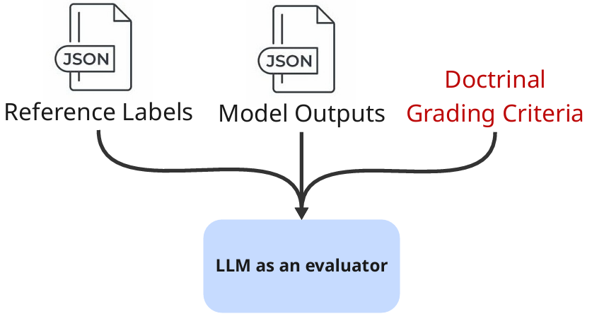
Evaluation
Inputs
Object Matching
Logic Evaluation
1. Group targets by target type.
2. Using bounding boxes, match predicted objects with reference objects.
3. Compare key attributes:
Damage level
Confidence
Reference Outputs
Model Outputs
Target type
Damage level
Confidence
Supporting logic
Produce logic quality scores.
Final Score = IoU - Attribute Penalties + Logic Quality
Notes:
For the purpose of the edge device, the model simply outputs a report and we are done.
However, a major goal of this project is rigorous evaluation – how do we know how well the model performs?
Our evaluation approach uses a custom metric to evaluate all aspects of the report:
Identifying the presence of individual targets in the scene
The correct doctrinal target type, damage level, and confidence level
The natural language – evaluating the written logic to support these fields
We use an object matching approach to parse fixed categories such as the target type, damage level, and confidence level.
We use an llm as a judge approach to evaluate the written logic.
The final score for each image is the combination of the structured accuracy minus any penalties for hallucinations or missed objects plus the llm as a judge logic quality.

Slide 23
Challenges
Integration of Phase 2 Functional Damage Assessment (FDA)s
Insufficient details
16GB GPU VRAM Limits Model Size
Approximate 8B limit
Mitigation: Testing Quantization Reductions
No way to test software on robot without full deployment

Slide 24
Future Work
Dataset Expansion
Model Evaluation Pipeline
Prompt Tuning
Object Detection Integration
Comprehensive Pipeline Testing
Docker Image Development

